Slide 1
Tener idioms
Spanish II

Slide 2
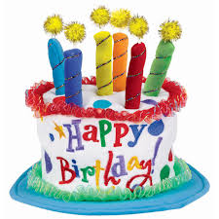
To be ___ years
Baby’s 1st Birthday

Slide 3
To be hot

Slide 4
To be careful
Walking the Tightrope

Slide 5
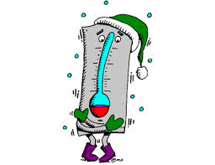
To be cold
Freezing T-shirt

Slide 6
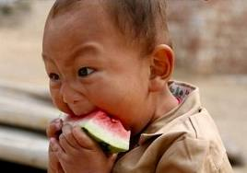
To be hungry
Big Bang Theory

Slide 7
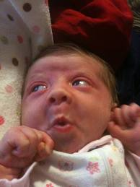
To be scared
Scaring Taylor Swift

Slide 8
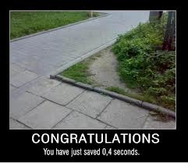
To be in a hurry
Firefighter Getting Dressed

Slide 9
To have to + infinitive

Slide 10
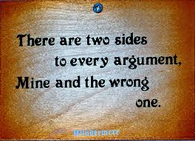
To be right

Slide 11
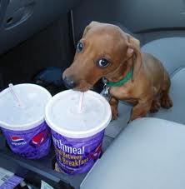
To be thirsty
Speed Drinking

Slide 12
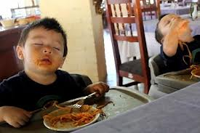
To be sleepy, tired
Twins Eating Spagetti
Eating Ice Cream

Slide 13
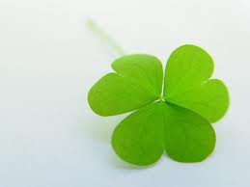
To be lucky
Being Lucky

Slide 14
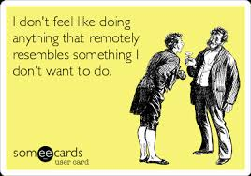
To feel like doing something

Slide 15
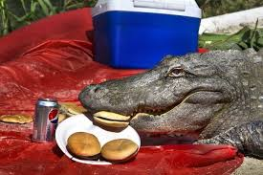
To have a picnic
A Camping Bear

Slide 16
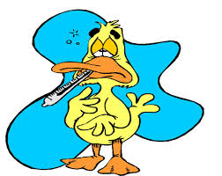
To have a cold

