Slide 1
ER / IR Verb List
Spanish I

Slide 2
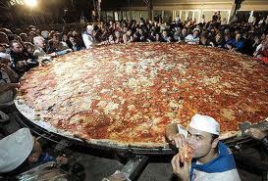
To Eat Comer

Slide 3
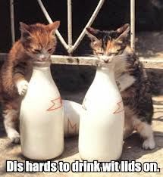
To Drink Beber

Slide 4
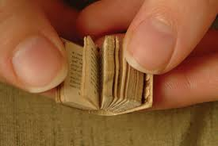
To Read Leer

Slide 5
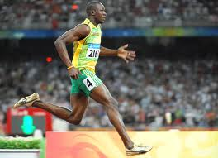
To Run Correr

Slide 6
To do Hacer

Slide 7
To do (exercise) hacer ejercicio

Slide 8
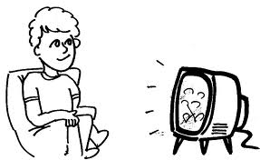
To watch TV ver la televisión

Slide 9
To watch movies ver las películas

Slide 10
To learn aprender

Slide 11
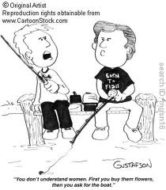
To Understand comprender

Slide 12
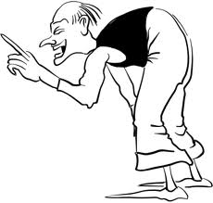
Must, Ought Deber
Conjugation of deber + INFINITIVE = should

Slide 13
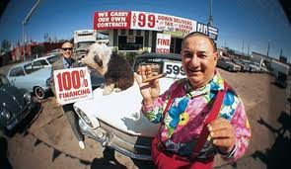
To Sell Vender

Slide 14
To Write Escribir

Slide 15
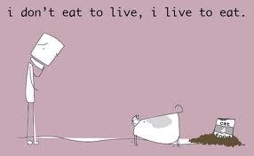
To Live Vivir

Slide 16
To Open Abrir

Slide 17
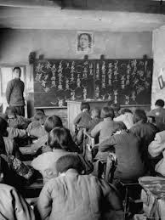
To Attend Asistir

Slide 18
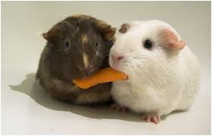
To Share Compartir

Slide 19
To Receive Recibir

Slide 20
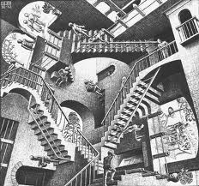
To Go Up Stairs Subir

Slide 21
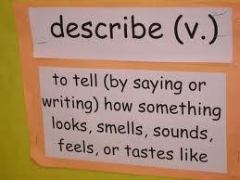
To describe Describir

