Slide 1
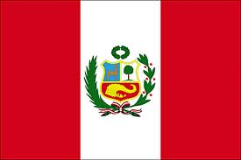
¡Exprésate! DOS Chapter 2
Cuzco, Peru

Slide 2
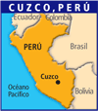
Información
Population: 300,000
Altitude: 3,400 meters about sea level
Historial Note: Cuzco was capital of Inca empire.
Economy: tourism, artists goods, agriculture

Slide 3
Cuzco
Situated near the Andes Mountains
Oldest city in South America
Was the capital of the Incan empire

Slide 4
El Templo del Sol
Was one of the most sacred place to the Incas
Spanish influence: now the Church of Santo Domingo

Slide 5
Orgullosas de su pasado
very proud of their past
traditional suits

Slide 6
Los Mercados
sell fruit, vegetables, herbs, textiles, typical foods

Slide 7
La Plaza de Armas
Is the center of old and modern Cuzco
Was once central plaza of the Incas
La Catedral de Cuzco
Spanish started its construction in 1560
Finished 94 years later

Slide 8
Las Paredes incas
In many buildings
Incan walls form the base of buildings from the colonial period

Slide 9
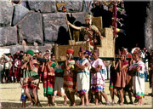
Inti Raymi
Festival of the Sun
Every June 24
Celebrates the New Year of the Incas
Most important festivals of the Incan empire

Slide 10
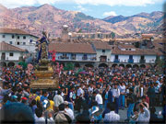
El Festival de Corpus Christi
During June
Lasts 1 week
Ends with huge parade
Combines Inca and Christian traditions

Slide 11
La Cuidad de Cuzco
puma: very special animal to the Incas
Constructed Cuzco using its form

Slide 12
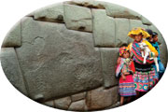
La Piedra de los doce ángulos
situated in a wall of Inca palace
Constructed with such precision that a credit card can’t slide in between the stones

Slide 13
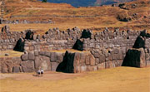
La impresionanate forteleza de Sacsayhuaman
forms the head of the puma
3 walls constructed in zig zag pattern
Possibly signifies puma’s teeth

Slide 14
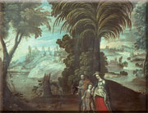
El Retorno a Egipto
painted by Diego Tito in 1680
Founded a Cuzco art school after destruction of artworks by earthquake in 1650

Slide 15
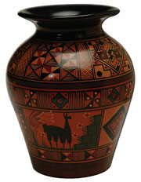
La cerámica cuzqueña
combines Inca and colonial traditions
simplicity of its forms and decorations are imitated in today’s art from Cuzco
Examples in Regional Historical Museum

Slide 16
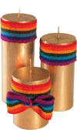
La cerería
another popular art of Cuzco
use decorated candles for numerous celebrations
example of Inca flag

Slide 17
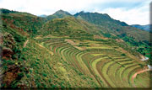
La agricultura
transformed the land from arid to fertile
allows agricultural production

Slide 18
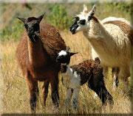
La lana
wool from the llamas and alpacas is the base of many famous textiles they sell at the markets

Slide 19
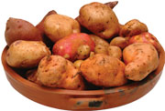
Muchos platos típico de Cuzco
prepared with potatoes
Hundreds of varieties

