Slide 1
Costa Rica
June 15, 2017 - June 23, 2017

Slide 2
Why Do I Travel?
About Ms. Hribal
insert photo & bio}
Why I chose this tour
Insert Photo of Yourself
the experience is everything

Slide 3
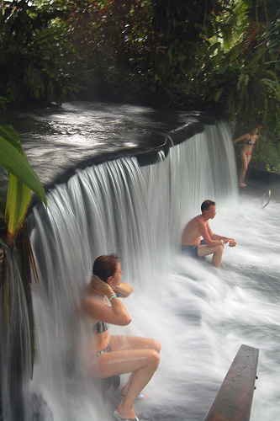
Why Should You Travel?
The Experience is Everything
Educational travel is a vital part of a
complete education. It expands views,
promotes understanding, and provides
first-hand experiences of classroom
lessons.
The majority of individuals that participated
in youth travel directly credit their travel
experiences as positively impacting their
education and career.
the experience is everything

Slide 4
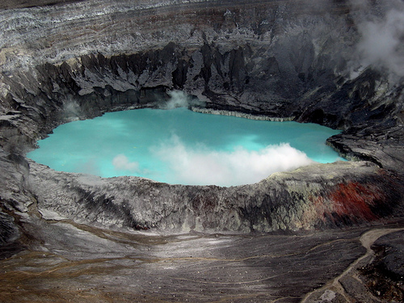
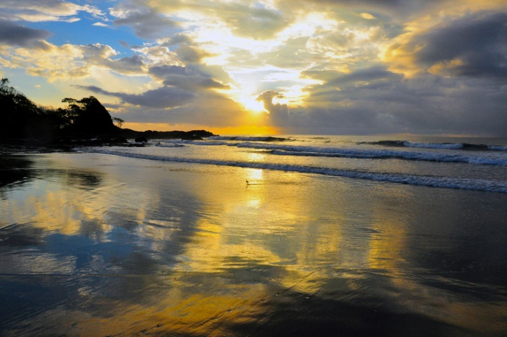
Highlights of What We’ll See
Manuel Antonio National Park
Hot Springs
Poás Volcano
Coastal Puntarenas

Slide 5
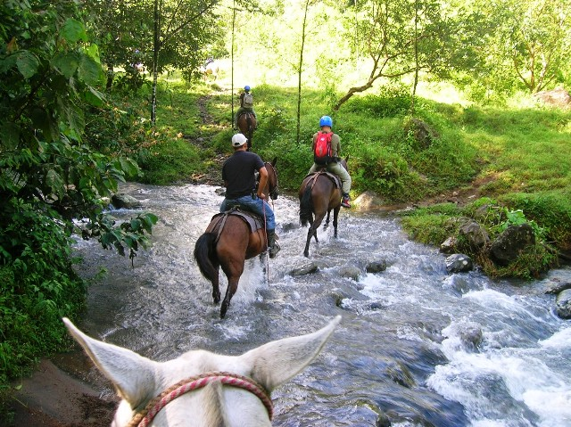
Tour Itinerary
Day 1 Hola San José
Meet your Tour Director and check into hotel
Day 2 San José--Arenal
Travel to Arenal via Poás Volcano
Poás Volcano
Day 3 Arenal Landmarks
Kayaking tour on Lake Arenal
Hanging Bridges Excursion
Hot Springs visit
Day 4 Arenal—Monteverde
Travel to Monteverde
Local School visit
Canopy Tour
the experience is everything

Slide 6
Tour Itinerary
Day 5 Monteverde Landmarks
Santa Elena Biological Reserve
Plant your own tree
Horseback ride
Day 6 Monteverde--Coastal Puntarenas
Travel to Coastal Puntarenas
Free time at the beach
Day 7 Manuel Antonio Excursion
Manuel Antonio National Park guided visit
Day 8 Coastal Puntarenas--San José
Travel to San José via Sarchí
Visit Craft Village of Sarchí
Optional Folklore evening $35
Day 9 End Tour
the experience is everything

Slide 7
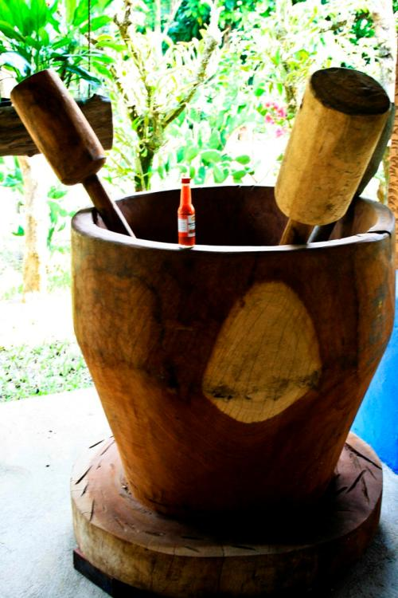
What’s Included?
Round-trip airfare
8 overnight stays (9 with extension) in hotels with private bathrooms
Breakfast daily
Lunch daily
Dinner daily
Full-time services of a professional Tour Director
Guided sightseeing tours and city walks as per itinerary
Visits to select attractions as per itinerary
Canopy Tour
Lake Arenal kayaking tour
Horseback ride
River rafting on extension
Tour Diary™
Note: On arrival day only dinner is provided; on departure day, only breakfast is provided
Note: Tour cost does not include airline-imposed baggage fees, or fees for any required passport or visa.
Additional Costs to Consider:
*Passports & Visas (if applicable)
*Tipping
*Checked-Baggage Fees
*Snacks, Beverages
*Souvenirs
*Free time activities
*Shore excursions (on cruise tours only)
*the cost of these items are not included in the total price
the experience is everything

Slide 8
Travel With Confidence
Travel Protection
4 out of 5 Explorica travelers protect their tours with the travel protection plan.
Travel Protection Plan
$12 per day (up to a maximum of $180).
Must be purchased by your last payment.
Travel Protection Plan Plus
$18 per day (up to a maximum of $270).
Must be purchased within 14 days of enrollment.
Questions: Call Tripmate 800-888-7292 Plan # F433E
To learn more about cancel for any reason and other benefits,
go online: http://www.explorica.com/Resources/Travel-Protection-Plan.aspx
the experience is everything
Notes:
Details on Trip Mate
A traveler’s injury, sickness, or death of an immediate family member.
Theft of passport or visas.
Flight cancellations or trip interruptions due to covered reasons such as sickness, injury, or death.
Trip cancellation or trip interruption due to terrorist acts
Explorica’s Travel Protection Plan PLUS includes “Cancel For Any Reason Benefit”
Allows travelers to cancel their tour for any reason up to two days before departure and receive most of their tour fee back in cash. That means recent events such as the Ash Cloud and the H1N1 outbreak were covered under our plan.

Slide 9
Travel Protection Details
Explorica’s Travel Protection Plan covers you for:
A traveler’s injury, sickness, or death of a family member.
Loss of passport or visas.
Flight cancellations due to strike or bad weather.
Loss of luggage and personal effects.
Trip Cancellation or Trip Interruption due to covered reasons such as a covered sickness, illness, injury or death.
Trip Cancellation or Trip Interruption due to defined Terrorist Acts.
Explorica’s Travel Protection Plan Plus covers you for:
Same benefits as standard plan PLUS Cancel for Any Reason Waiver Benefit.
With the Cancel for Any Reason Waiver Benefit, if you cancel your trip by 30 days prior to your departure for any reason not otherwise covered by this policy, TripMate will reimburse you for 75% of the non-refundable cancellation fees which apply to your trip.
Please see Terms & Conditions for complete information regarding Travel Protection Plans.
the experience is everything
Notes:
Details on Trip Mate
A traveler’s injury, sickness, or death of an immediate family member.
Theft of passport or visas.
Flight cancellations or trip interruptions due to covered reasons such as sickness, injury, or death.
Trip cancellation or trip interruption due to terrorist acts
Explorica’s Travel Protection PLUS includes “Cancel For Any Reason Benefit”
Allows travelers to cancel their tour for any reason up to two days before departure and receive most of their tour fee back in cash. That means recent events such as the Ash Cloud and the H1N1 outbreak were covered under our plan.

Slide 10
Pricing Details
See detailed pricing at: http://www.explorica.com/Ribal-8496
Total Student Cost: $2,235*
Adults (23+) add $410
*To receive this discounted price, participants must sign up by March 31, 2016, and use the voucher code 2017EarlyBird at time of enrollment.
*Have you traveled with Explorica before? Then take an additional $100 off the tour cost!
the experience is everything

Slide 11
Payment Options
Automatic Monthly Payment Plans
$50 Deposit (and optional travel protection) paid upon registration
Billed automatically to your credit card or checking account
Auto-withdrawals on either the 5th or 20th of the month
Balance divided into equal monthly payments until
See the Tour Center for the current monthly payment amount.
Manual Payment Plan – 4 step
$99 Deposit (and optional travel protection) paid upon registration
Payments are not automatically withdrawn
30 days after registration, 2nd payment of $500 is due
75% of your balance due 105 days prior to departure
Remainder balance due 65 days prior to departure
Can be a good option for fundraisers
Pay in Full
Entire balance paid upon registration
Payments by check or credit card
the experience is everything

Slide 12
Passport & Visa Reminder
Obtain a Passport
You must have a valid passport to leave and reenter the country; this includes trips to Canada and Mexico. You should begin your application process shortly after enrolling on tour to ensure that your passport arrives on time and to validate the information with Explorica.
Visit the U.S. State Department Passport Information page for complete information on how to apply for a new passport.
Renew Your Passport
Make sure you check your passport’s expiration date which can be found on the data page in your passport. Some countries will not allow travelers to enter their country if they have less than 6 months of validity left on their passport, visit the U.S. State Department International Travel Information page for country specific information.
Obtain a Visa
Some countries require that you obtain official authorization (called a visa) before entering their country. You are responsible for obtaining any necessary visas.
You must have a valid passport before you can obtain a visa, so it is very important to apply for or renew your passport well in advance.
the experience is everything

Slide 13
Enrolling Online is Easy
Visit www.explorica.com
Find the “Students: Sign Up” button and then click to go to the next page
the experience is everything

Slide 14
Enter the Tour Center ID
Ribal-8496
the experience is everything

Slide 15
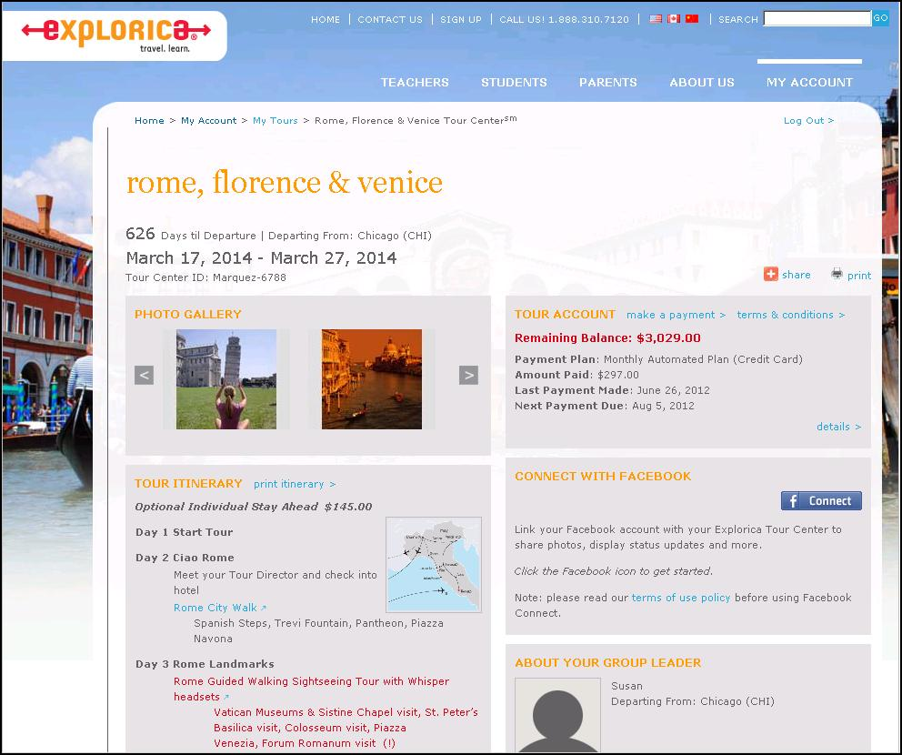
Easy Online Payments
the experience is everything
Notes:
Travelers get their own individual Explorica accounts with username and passwords. The search engine let’s you find quick and easy answers to your questions. Everything you could need is online.

Slide 16
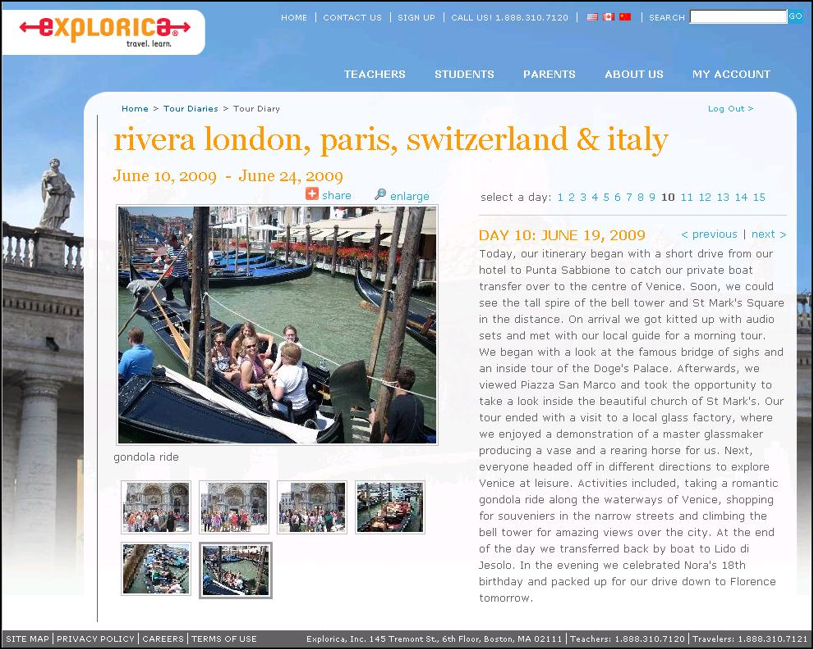
Online Tour Diary
Watch your travelers on tour day by day. Share your tour diary with friends & family!
the experience is everything

Slide 17
What’s it Like Being on Tour?
Watch this video!
the experience is everything
Notes:
Image: Video. Remember to make sure the powerpoint is in slideshow mode to show the video. Just click the play button. Video is 4 minutes http://www.explorica.com/resources/videos.aspx

Slide 18
Contact Explorica
Email
info@explorica.com
Mail
Explorica, Inc. 145 Tremont St., Fl. 6 Boston, MA 02111
Fax
1.888.310.7088
Phone
1.888.310.7121
the experience is everything

Slide 19
Questions?

