Slide 1
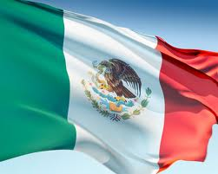
Cinco de Mayo
Spanish I

Slide 2
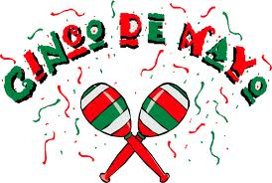

Slide 3
What does it mean?
Cinco de Mayo
5th of May

Slide 4
Important Dates
Our Independence Day:
July 4
Mexico’s Independence Day:
September 16

Slide 5
Information
commemorates the Mexican army's 1862 victory over France
at the Battle of Puebla during the Franco-Mexican War

Slide 6
Information
minor holiday in Mexico
evolved into a celebration of Mexican culture and heritage in U.S.
include parades, mariachi music performances and street festivals

Slide 7
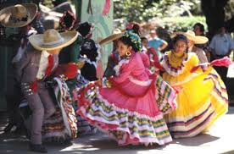

Slide 8
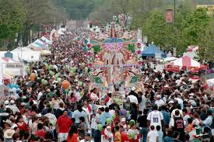

Slide 9
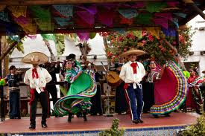

Slide 10
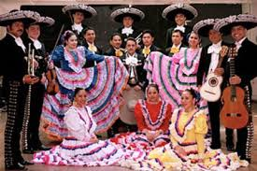

Slide 11
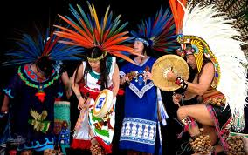

Slide 12
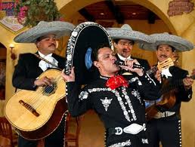

Slide 14
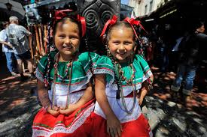

Slide 15
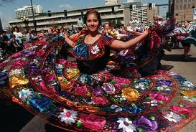

Slide 16
Videos
History of Cinco de Mayo, really?!?
The REAL of the History of Cinco de Mayo
Cinco de Mayo

