Slide 1
Adjectives with ser
Spanish II

Slide 2
Agradable: pleasant

Slide 3
Amable: kind, nice

Slide 4
Correcto: correct, right

Slide 5
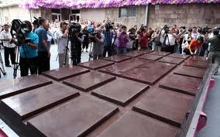
Dulce: sweet
World's Largest Hershey's Kiss

Slide 6
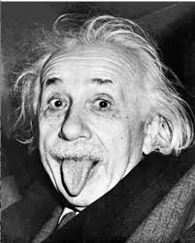
Educado: educated
The Big Bang Theory

Slide 7
enÉrgico: energetic
Energetic Dog

Slide 8
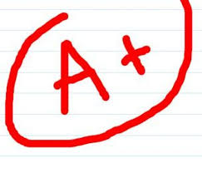
Estupendo: stupendous

Slide 9
Excelente: excellent

Slide 10
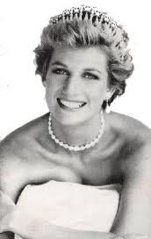
Famoso: famous
Who is the most photographed person of all time?
Who is the most photographed person in the world of all time?

Slide 11
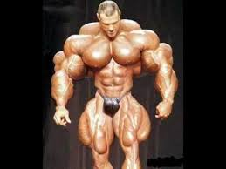
Fuerte: strong
1155 POUNDS!!

Slide 12
Generoso: generous

Slide 13
Gracioso: amazing

Slide 14
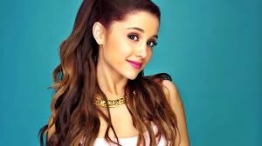
Grande: big
"Big" with Tom Hanks

Slide 15
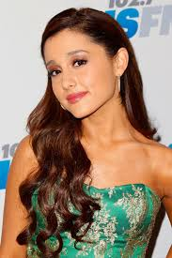
Hermoso: beautiful

Slide 16
Honesto: honest

Slide 17
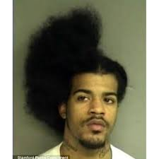
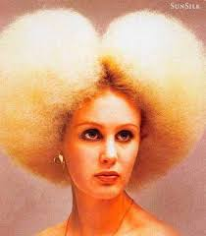
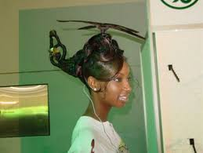
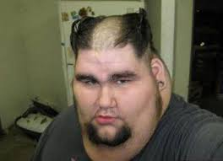
Horrible: horrible

Slide 18
Impaciente: impatient
You wanna play?
You wanna play?
You wanna play?

Slide 19
INcompleto: incomplete
Time-Lapsed Construction of Sagrada Familia 1882-2026

Slide 20
Largo: long

Slide 21
Loco: crazy
Livin' the Vida Loca

Slide 22
Nuevo: new

Slide 23
Paciente: patient
Doggie Treat

Slide 24
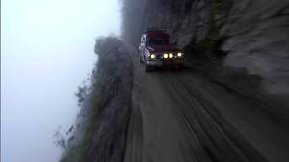
Peligroso: dangerous
Dangerous Road

Slide 25
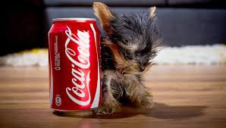
pequeÑo: little
Tiny Terrier

Slide 26
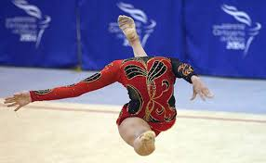
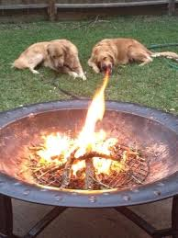
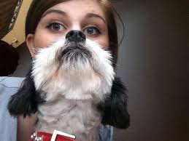
Perfecto: perfect

Slide 27
Solo: alone, single

