Slide 1
¡Exprésate! UNO Chapter 9
Vocabulario 9-2
Preparing for a Party

Slide 2
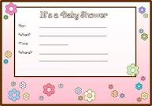
To send invitations

Slide 3
To send invitations mandar invitaciones

Slide 4
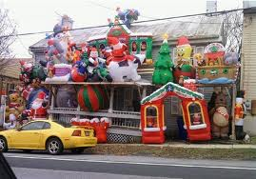
To decorate

Slide 5
To decorate colgar (ue) decoraciones
Halloween Light Show
National Lampoon's Christmas Vacation

Slide 6
decorations

Slide 7
Decorations las decoraciones

Slide 8
Balloons

Slide 9
Balloons los globos

Slide 10
To show pictures

Slide 11
To show pictures enseñar fotos

Slide 12
To talk, to chat

Slide 13
To talk, to chat charlar

Slide 14
To tell jokes

Slide 15
To tell jokes contar (ue) chistes

Slide 16
Guests

Slide 17
Guests los invitados Dinner Guests

Slide 18
anniversary

Slide 19
Anniversary el aniversario

Slide 20
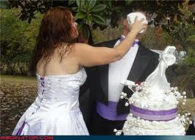
Wedding Wedding Reception Dance

Slide 21
Wedding la boda Wedding Reception Dance

Slide 22
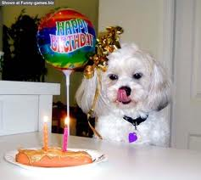
birthday

Slide 23
Birthday el cumpleaños Birthday Blooper

Slide 24
Your saint’s day

Slide 25
Your saint’s day el día de tu santo

Slide 26
Surprise party SNL Surprise Party Skit SNL Surprise Party Lipsync

Slide 27
Surprise party la fiesta sorpresa SNL Surprise Party Skit SNL Surprise Party Lipsync

Slide 28
graduation

Slide 29
Graduation la graduación Graduation Speech Blooper

Slide 30
Girl’s 15th birthday

Slide 31
Girl’s 15th birthday la quinceañera Quinceañera Dance

Slide 32
appetizers

Slide 33
Appetizers los entremeses Valentine Sushi

Slide 34
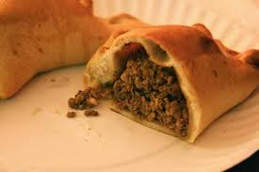
Turnover-like pastries How to Make Empanadas

Slide 35
Turnover-like pastries las empanadas How to Make Empanadas

Slide 36
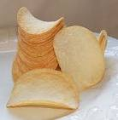
Potato chips

Slide 37
Potato chips las papitas Potato Chip Commercial

Slide 38
candy, sweets How to Make Candy Canes

Slide 39
candy, sweets los dulces How to Make Candy Canes

Slide 40
Dominican tamales How to Make Pasteles en Hoja

Slide 41
Dominican tamales los pasteles en hoja How to Make Pasteles en Hoja

Slide 42
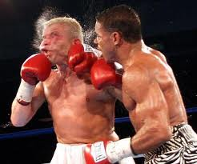
punch

Slide 43
Punch el ponche

Slide 44
flowers

Slide 45
Flowers las flores Telefloral Commerical

Slide 46
cookies

Slide 47
cookies las galletas Making a Cookie Monster

Slide 48
Now
ahora

Slide 49
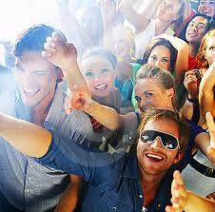
Young People
Los jóvenes

Slide 50
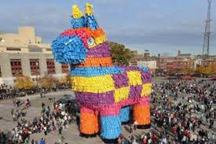
piñata
La piñata

Slide 51
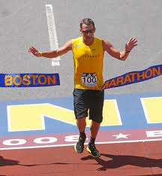
To finish
Terminar

Slide 52
To know, to meet
Conocer (a)

Slide 53
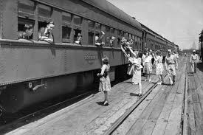
Bye! I’ll call you later.
¡Chao! Te llamo más tarde.

Slide 54
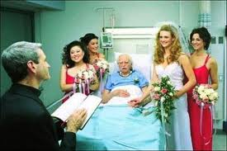
Happy Anniversary!
¡Feliz Aniversario!

Slide 55
Good to see you!
¡Qué gusto verte!

Slide 56
Nice to meet you.
Tanto gusto.

Slide 57
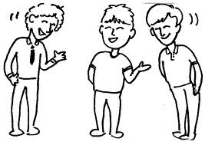
I’d like you to meet…
Te presento a…

Slide 58
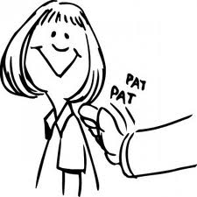
Take care!
¡Ten cuidado!

Slide 59
What’s new?
¿Qué hay de nuevo?

Slide 60
Same as usual.
Lo de siempre.

Slide 61
Okay. Hope things go well for you.
Vale. Que te vaya bien.

Slide 62
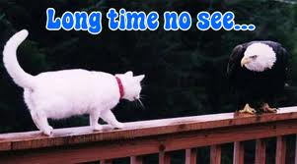
Long time. No see.
¡Tanto tiempo sin verte!

