Slide 1
¡Exprésate! UNO
Chapter 4-1
Classroom Vocab / Classes

Slide 2

The school supplies

Slide 3
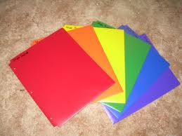
the folder

Slide 4
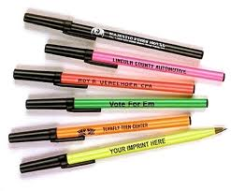
the pen

Slide 5
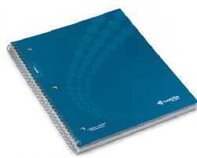
the notebook

Slide 6
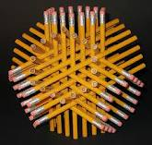
the pencil

Slide 7
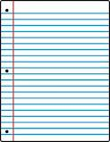
The paper

Slide 8
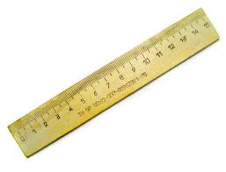
the ruler

Slide 9
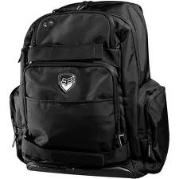
the backpack

Slide 10

the dictionary

Slide 11

the flag

Slide 12

the locker

Slide 13
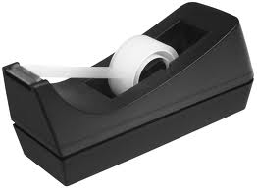
The tape

Slide 14
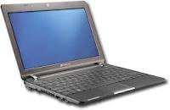
The computer

Slide 15
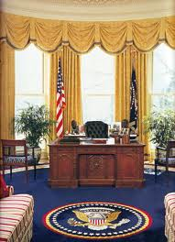
the teacher’s desk

Slide 16
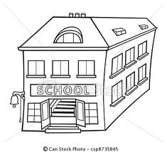
The school

Slide 17
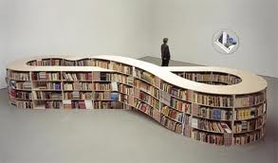
The bookshelf

Slide 18

The student

Slide 19
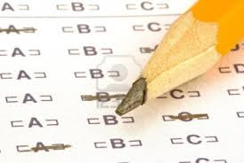
The test

Slide 20
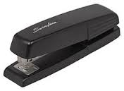
The stapler

Slide 21
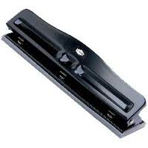
The 3-hole punch

Slide 22
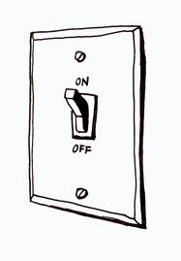
The light

Slide 23

The colored pencils

Slide 24
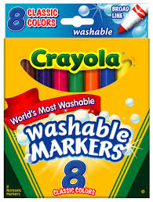
The markers

Slide 25
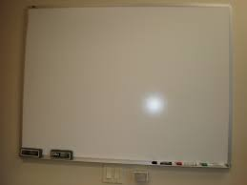
The white board

Slide 26
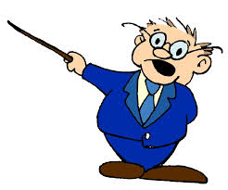
The teacher

Slide 27

The quiz

Slide 28
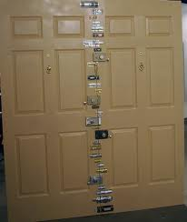
The door

Slide 29
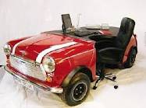
The student desk

Slide 30
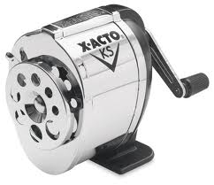
The pencil sharpener

Slide 31
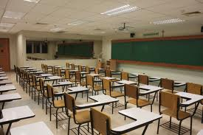
The classroom

Slide 32
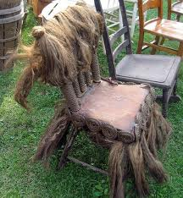
The chair

Slide 33
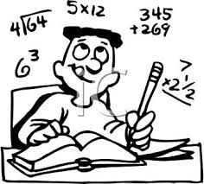
The homework

Slide 34
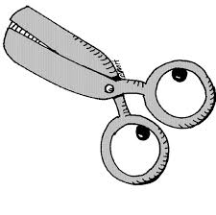
The scissors

Slide 35
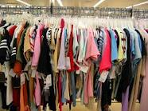
The clothes

Slide 36
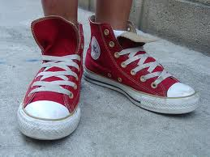
The shoes

Slide 37
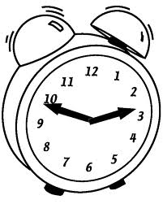
the clock

Slide 38

German (class)

Slide 39

Science (class)

Slide 40
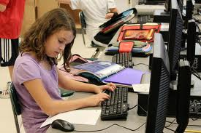
Computer science (class)

Slide 41

French (class)

Slide 42

Chemistry (class)

Slide 43
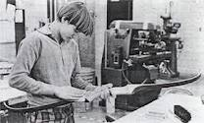
Shop / workshop (class)

Slide 44

Art (class)

Slide 45
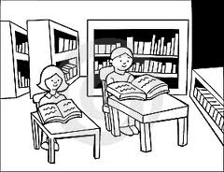
library

Slide 46

P.E. (class)

Slide 47

Spanish (class)

Slide 48

History (class)

Slide 49

English (class)

Slide 50

Math (class)

Slide 51
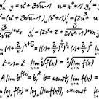
Algebra (class)

Slide 52

Music (class)

Slide 53

In the morning

Slide 54

In the afternoon

