Slide 1
¡Exprésate! DOS Chapter 2-2
Vocabulary 2-2
House Vocabulary

Slide 2
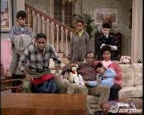
Living room

Slide 3
Living room la sala

Slide 4
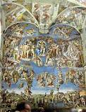
ceiling

Slide 5
Ceiling el techo

Slide 6
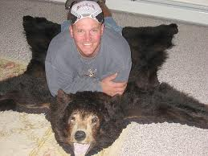
Carpet, rug

Slide 7
Carpet, rug la alfombra

Slide 8
painting

Slide 9
Painting el cuadro

Slide 10
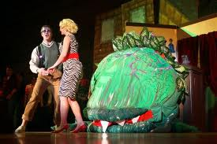
To water the plants

Slide 11
To water the plants regar (e-ie) las plantas

Slide 12
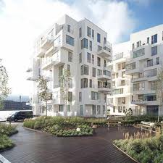
apartment

Slide 13
Apartment el apartamento

Slide 14
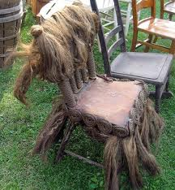
armchair

Slide 15
Armchair el sillón

Slide 16
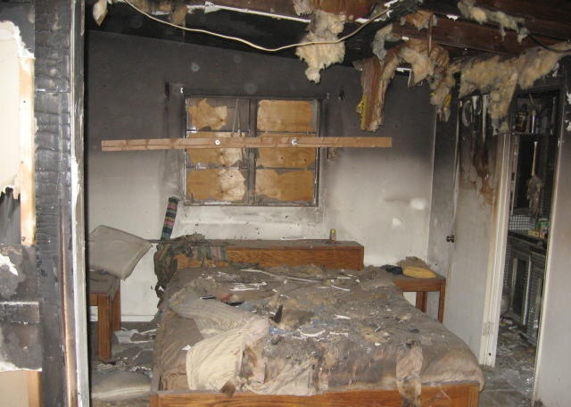
bedroom

Slide 17
Bedroom la habitación

Slide 18
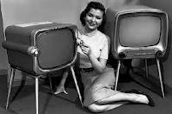
television

Slide 19
Television el televisor

Slide 20
lamp

Slide 21
Lamp la lámpara

Slide 22
wall

Slide 23
Wall el pared

Slide 24
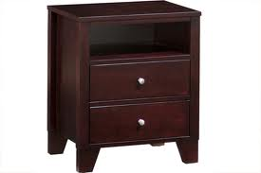
nightstand

Slide 25
Nightstand la mesita de noche

Slide 26
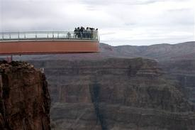
floor

Slide 27
Floor el piso
Floor #2
Floor #3

Slide 28
bookcase

Slide 29
Bookcase el estante

Slide 30
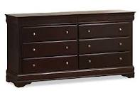
Chest of drawers / dresser

Slide 31
Chest of drawers / dresser la cómoda

Slide 32
To dust the furniture

Slide 33
To dust the furniture sacudir los muebles

Slide 34
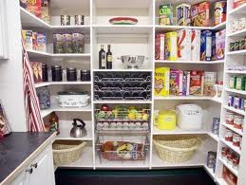
To organize

Slide 35
To organize organizar

Slide 36
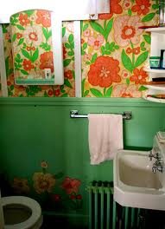
bathroom

Slide 37
Bathroom el baño

Slide 38
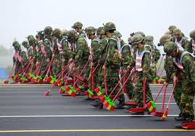
To sweep
Sweeping #2
Sweeping #3

Slide 39
To sweep barrer
Sweeping #3
Sweeping #2

Slide 40
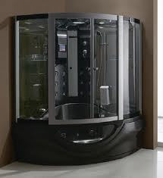
shower
Shower #2

Slide 41
Shower la ducha
Shower #2

Slide 42
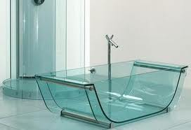
bathtub
Tub Clip

Slide 43
Bathtub la bañera
Tub Clip

Slide 44
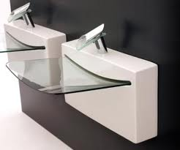
(bathroom) sink

Slide 45
(bathroom) sink el lavabo

Slide 46
toilet
Toilet #1
Toilet #2

Slide 47
Toilet el inodoro

Slide 48
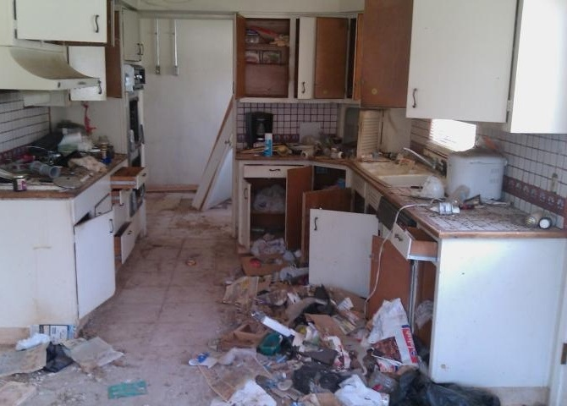
kitchen

Slide 49
Kitchen la cocina

Slide 50
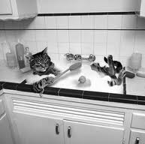
(kitchen) sink

Slide 51
(kitchen) sink el fregadero

Slide 52
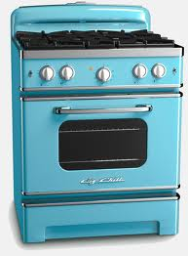
stove

Slide 53
Stove la estufa

Slide 54
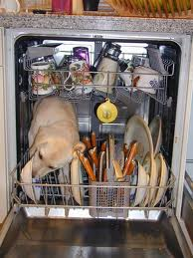
dishwasher
Dishwasher #2

Slide 55
Dishwasher el lavaplatos
Dishwasher #2

Slide 56
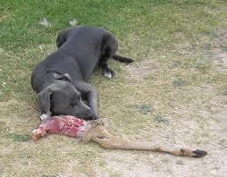
To feed the dog
Feeding the Dogs #1
Feeding the Dogs #2

Slide 57
To feed the dog darle de comer al perro

Slide 58
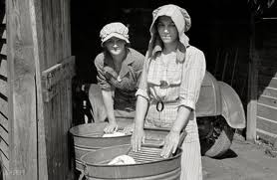
Washing machine
Washing Machine Dance #1
Washing Machine Dance #2
Washing Machine Dance #3

Slide 59
Washing machine la lavadora

Slide 60
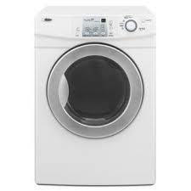
dryer
Dryer #2

Slide 61
Dryer la secadora
Dryer #2

Slide 62
To the right (of)

Slide 63
To the right (of) a la derecha (de)

Slide 64
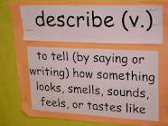
To describe

Slide 65
To describe describir

Slide 66
inside

Slide 67
Inside adentro

Slide 68
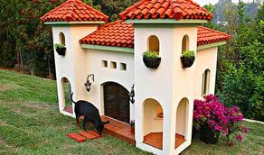
outside

Slide 69
Outside afuera

Slide 70
To the left (of)

Slide 71
To the left (of) a la izquierda (de)

Slide 72
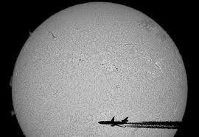
In front of, facing

Slide 73
In front of, facing enfrente de

Slide 74
(in) between

Slide 75
(in) between entre

