Slide 1
Spanish Sra. Ford A205
Syllabus Review

Slide 2
Videos
Spanish I and II
Spanish III

Slide 3
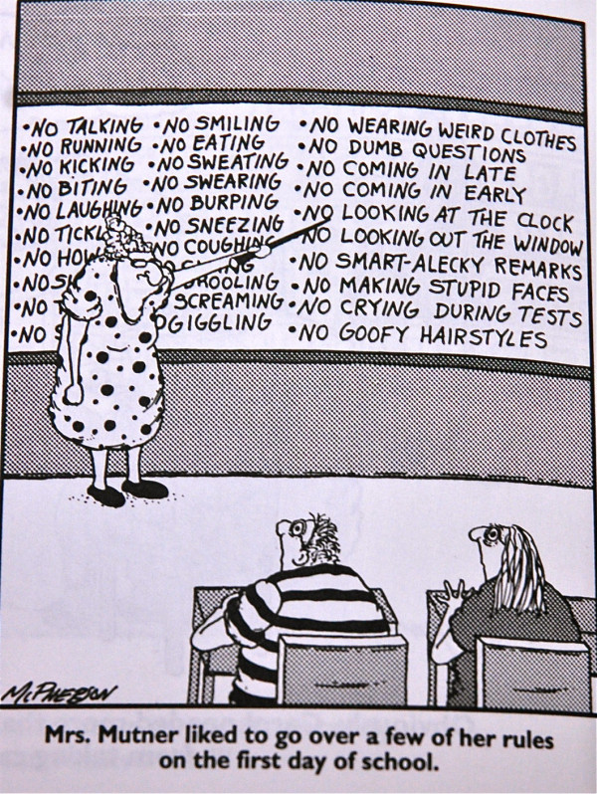

Slide 4
What you Need EVERYDAY…
Textbook and workbook (if applicable)
Binder with paper
Pencil, pen
Composition notebook (keep in classroom)

Slide 5
What You Need to Bring In / Have…
1 pack of index cards
USB drive
Earbuds/headphones
Tissues (II)
Sanitizer (III and IB III)

Slide 6
Classroom Expectations
Be respectful.
Be on time.
Be prepared. (Have your stuff.)
Be involved. (Participate.)
Follow directions.
NO throwing objects, unless directed by me.

Slide 7
Weighted Grades
TESTS: 60%
QUIZZES: 30%
HOMEWORK: 10%
Running Total in INOW

Slide 8
REMIND
FREE!
Text special code to special number
Daily texts with homework, reminders, etc.
Will give you time in class to sign up

Slide 9
Types of Work
Completion (Stamp Sheet)
Graded
Tests
Quizzes
CFA

Slide 10
Missed Work
YOUR responsibility
Get most missed work from Weebly website
# of days missed = # of days you have to turn work in
INOW grade stays a “0” until work is turned in

Slide 11
Late Work
2 conditions
Turned in BY the next school day
UP TO 50% of original value

Slide 12
Cell Phones / Electronics / iPads
Off
OK at certain times with my permission
ONE warning!
2nd offense: confiscate phone and turn in to office
Applies to earbuds as well

Slide 13
Writing Plan
A lot of writing
Levels 1 and 2

Slide 14
Cheating
DON’T DO IT!
Call home
Failing grade on assignment (HW, quiz, test, project)
Kicked out of class
“F” on transcript

Slide 15
Online Translator
NOT ALLOWED unless I say it’s ok
SINGLE WORDS ONLY!
Not entire phrases
Aren’t grammatically correct
I can tell if you use them
Won’t learn material
Lose some/all points on assignment
May be asked to redo assignment

Slide 16
Communication
aford@nafcs.k12.in.us
www.mrsfordfchsspanish.weebly.com
School phone
Before/after school
Between classes
My planning period: 7th

Slide 17
Online Textbooks
For Textbooks and Workbooks (I and II levels)
http:my.hrw.com/
Username: dosj2
Password: a5d2n

Slide 18
Additional Help
Online Websites
National Honor Society
Spanish IV students
Private tutor
Mr. Schellenberg after school

Slide 19
Additional Routines and Important Information
Bell DOES NOT dismiss you.
No standing around the door waiting for bell.
My desk is OFF LIMITS.
Return items you used during class
Bring planner to class (for hall passes)

Slide 20
REMIND texts
Text 81010
With the code:
(for Spanish II) @fcspanish
(for Spanish III) @fcsp3
(for Spanish IB III) @fcsp3ib

Slide 21
Continued…
Remind sign up
Daily Sponge / notebook on shelf
Passing in Work
Tissues / Sanitizer
INOW issues sheet
Hall Passes / Hall Pass Log

