Slide 1
Name that Country South America
Spanish II

Slide 2
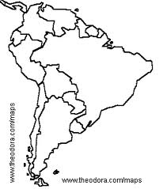
Venezuela

Slide 3
Peru

Slide 4
Ecuador

Slide 5
Colombia

Slide 6
Uruguay

Slide 7
hil
Chile

Slide 8
Paraguay

Slide 9
Argentina

Slide 10
Bolivia

Slide 11
Pacific Ocean

Slide 12
Atlantic Ocean

Slide 13
Let’s Try Again!

Slide 14
Uruguay

Slide 15
Peru

Slide 16
Colombia

Slide 17
hil
Chile

Slide 18
Bolivia

Slide 19
Ecuador

Slide 20
Atlantic Ocean

Slide 21
Venezuela

Slide 22
Argentina

Slide 23
Pacific Ocean

Slide 24
Paraguay

Slide 25
One More Time!

Slide 26
Argentina

Slide 27
hil
Chile

Slide 28
Colombia

Slide 29
Paraguay

Slide 30
Venezuela

Slide 31
Uruguay

Slide 32
Peru

Slide 33
Pacific Ocean

Slide 34
Atlantic Ocean

Slide 35
Ecuador

Slide 36
Bolivia

