Slide 1
Shopping Vocabulary
Spanish II

Slide 2
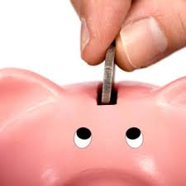
To save ahorrar

Slide 3
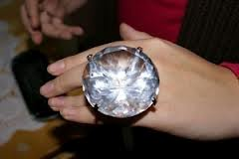
Ring el anillo
Marriage Proposal

Slide 4
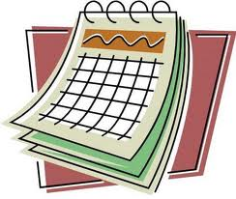
Day before yesterday anteayer

Slide 5
Yesterday ayer

Slide 6
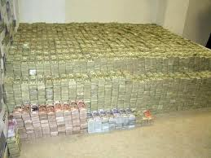
Money el dinero
Money!!

Slide 7
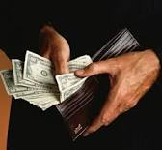
To spend gastar
$1 Million Dollars

Slide 8
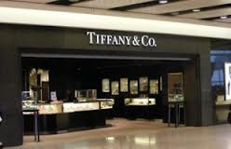
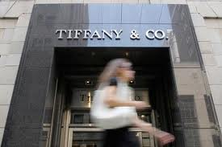
The jewelry store la joyería

Slide 9
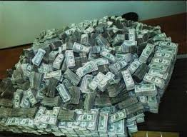
To pay a fortune pagar una fortuna

Slide 10
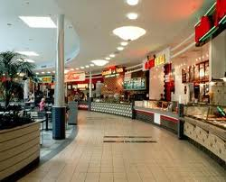
Food court la plaza de comida
Surprise!

Slide 11
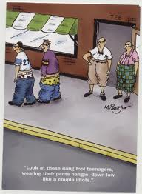
Birthday card la tarjeta de cumpleaños
Talented Dog

Slide 12
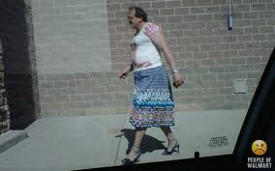
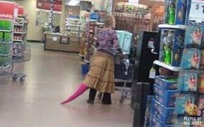
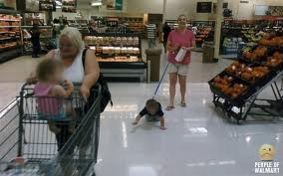
The _____store la tienda de…

Slide 13
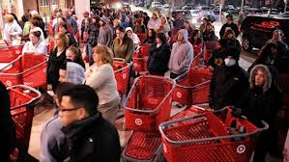
To sell (everything) vender (de todo)

Slide 14
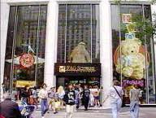
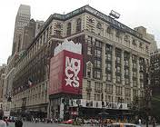
Department store el almacén

Slide 15
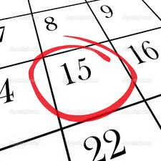
Last night anoche

Slide 16
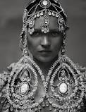
Earrings los aretes
Tribal Traditions

Slide 17
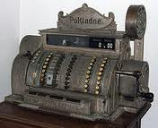
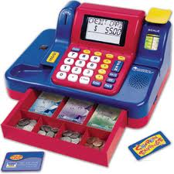
To buy comprar

Slide 18
DVD el DVD

Slide 19
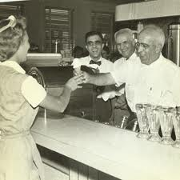
Ice cream shop la heladería
Sugar Cones

Slide 20
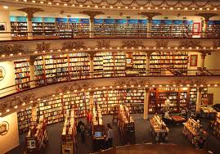
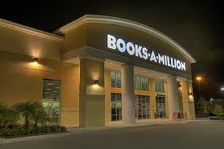
Book store la librería
Book in Your Trousers

Slide 21
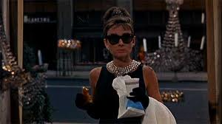
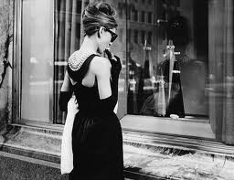
To window shop mirar las vitrinas
Breakfast at Tiffany's

Slide 22
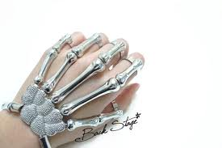
Bracelet la pulsera
Bracelet

Slide 23
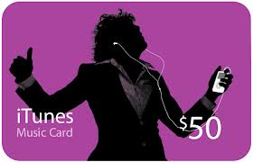
Gift card la tarjeta de regalo
That's a Big Word!

Slide 24
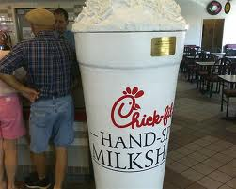
To have a milkshake tomar un batido
My Milkshake Brings All the Boys to the Yard!

Slide 25
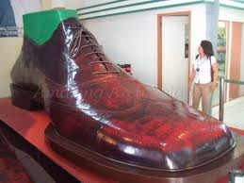
Shoe store la zapatería

