Slide 1
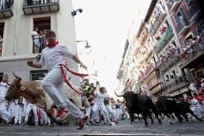
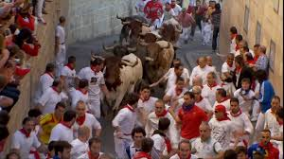
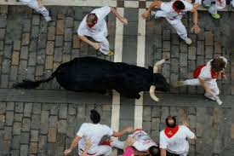
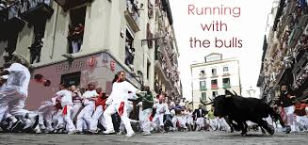
Festival de San Fermín
Español III

Slide 2
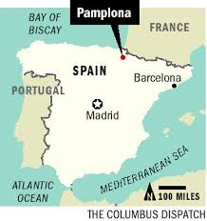
In Pamplona, Spain
July 7-14 every year
7-day long party full of bull-running, music, and dancing
Started in 1591

Slide 3
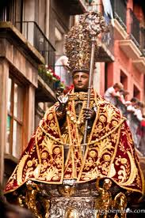
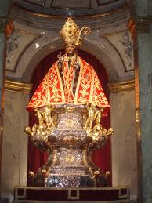
Originally a religious festival to celebrate the patron saint of Navarra, Saint Fermin
The tradition of the Running of the Bulls has gained international recognition
Now more than a local religious celebration
Now over 200,000 visitors come to Pamplona for the fiesta
Bringing in over $30 million to Pamplona

Slide 4
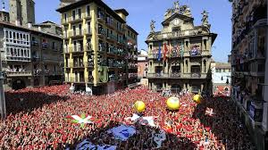
On July 6 is the chupinazo (firing of a rocket from balcony of town hall at noon to kick off festival).

Slide 5
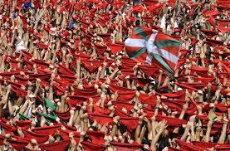
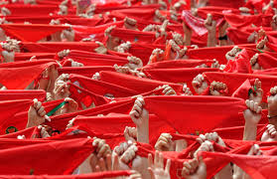
The plaza surrounding Town Hall is full of revellers holding up red hankerchiefs in the air and shout “¡Viva San Fermín! ¡Gora San Fermín!”

Slide 6
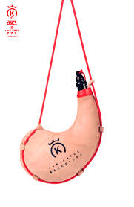
Calimocho: traditional drink red wine and Coke

Slide 7
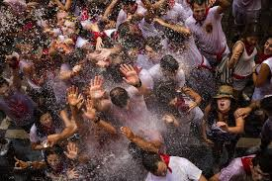

Slide 8
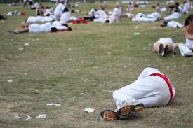
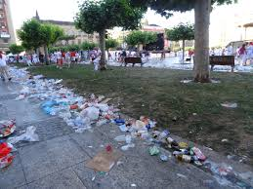
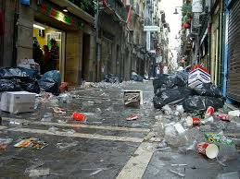
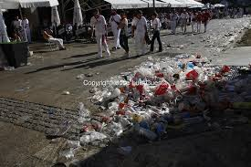
Street cleaners collect over 66,000 pounds of glass from the square after the firing of the rocket.
During the whole festival, over 1,000 TONS of trash are picked up.

Slide 9
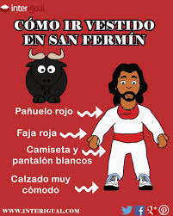
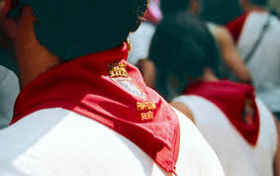
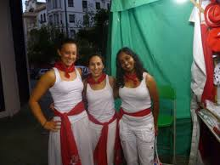
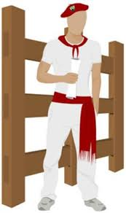
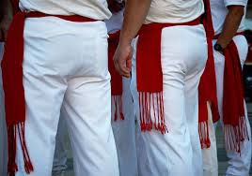
Traditional outfit of festival-goers

Slide 10
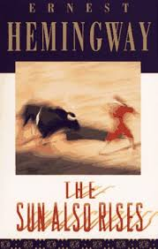
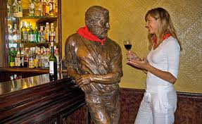
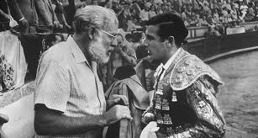
The tradition of the Running of the Bulls (el encierro) came from the difficult task of transporting bulls from the pens to the bullring.
The bulls were simple led along the town streets to the bullring.
Some risk-takers found in amusing to run in front of the bulls. So, the tradition began.
Became internationally-known through Ernest Hemingway’s book “The Sun Also Rises” which told about the bull-running festival in Pamplona.

Slide 11
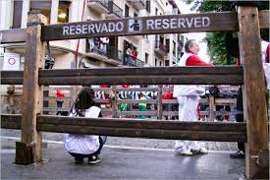
El Encierro: Running of the Bulls
6 fighting bulls and 6 other steers
Course is about ½ mile
Through center of town from corral to Plaza de Toros (bullring)
Course is heavily protected with barriers
Security and ambulance staff on hand to be as safe as possible

Slide 12
Interactive Route Map

Slide 13
FIREWORKS
First firework goes off at 8:00 am: signals that the pen has been opened.
Second firework: signals that all bulls are now out of the corral.
Third firework: signals that all bulls have entered the bullring.
Final firework: signals that all bulls are in the pen at the bullring.
This signifies the end of the bullrun for that day.
Usually only lasts 2-3 minutes

Slide 14
How dangerous is it?
Since 1900, there have been 15 deaths and 200 seriously injured by bulls’ horns.
Rarely an injury-free encierro
Majority of injuries are caused by the runners themselves, running into each other or tripping and concussions

