Slide 1
Injury and illnesses Vocab
Spanish III

Slide 2
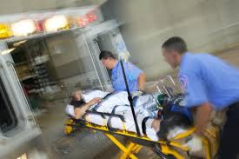
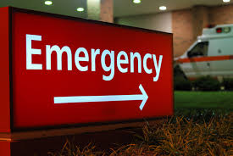
Emergency room la sala de emergencia
Aren't they supposed to help?!

Slide 3
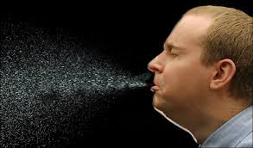
To sneeze estornudar
Super Slow Mo

Slide 4
What happened to you? ¿QuÉ te pasÓ?

Slide 5
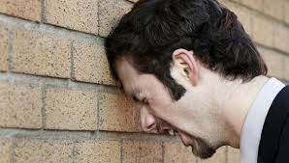
I hit my … against … Me di un golpe en … en …
Karma

Slide 6
What’s the matter with you? ¿QuÉ tienes?

Slide 7
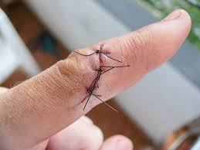
I cut… Me cortÉ…

Slide 8
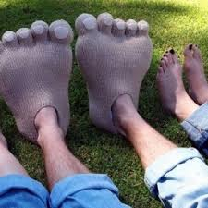
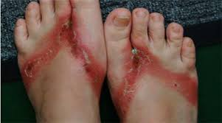
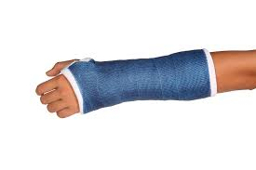
Now it’s infected/swollen/twisted/hurt/broken.
Ahora lo tengo :
infectado(a)
hinchado(a)
torcido(a)
herido(a)
roto(a)

Slide 9
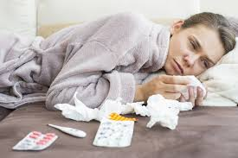
To have a cold estar con gripa tener catarro

Slide 10
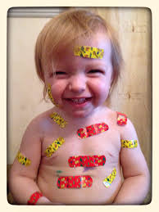
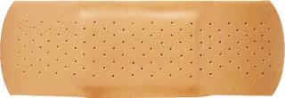
To put on (band-aid) ponerse una curita

Slide 11
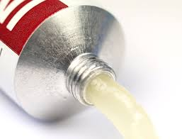
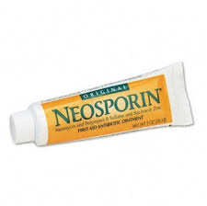
Ointment el ungÜento

Slide 12
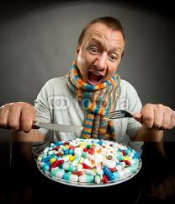
To take some pills tomarse unas pastillas

Slide 13
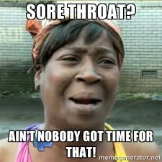
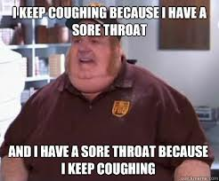
To have a cough tener toz

Slide 14
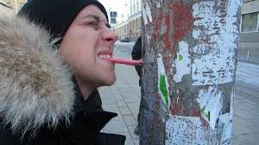
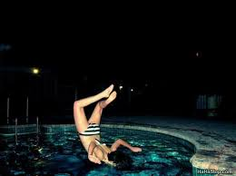
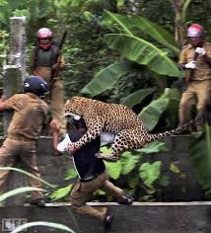
To hurt doler (o-ue) (use me, te, le, nos, os, les like gustar)
I triple dog dare ya!

Slide 15
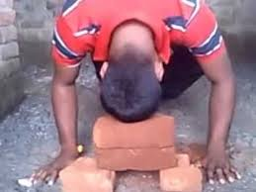
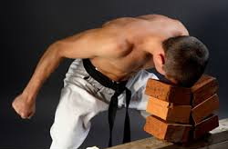
To have a headache tener un dolor de cabeza
I think I can! I think I can!

Slide 16
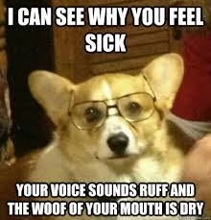
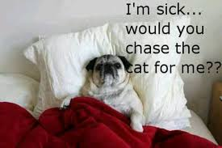
To Stay in bed Quedarse en cama

Slide 17
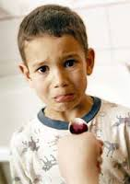
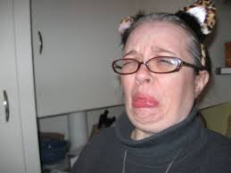
To take cough syrup tomar el jarabe
Open wide!

