Slide 1
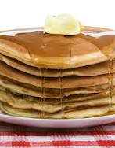
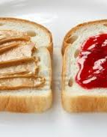
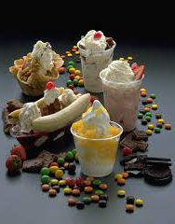
“How To” PROJECT
Spanish II

Slide 2
How To Project
Individual or with ONE partner
Can be recorded (shown in class), done LIVE in class, or PowerPoint/orally in class
Will begin presentations in class on Monday, February 3
Draw will determine which “How To” you will do
Required: (at least) 3 affirmative informal commands and 3 negative informal commands (Verbs are to be used ONLY ONCE!)
Typed script, 12 point, double-spaced (for EVERYONE due: Monday, February 3)
Date to present to class will be assigned after all individual/partners have drawn

Slide 3
“How To” Project Grading Rubric
Visual aid used (in video, in live class presentation, PowerPoint)
Typed script turned in on due date (Monday, February 3)
3 negative informal commands (minimum) correctly used
3 affirmative informal commands (minimum) correctly used
Vocabulary used
Pronunciation
Effort
Flow/Fluency

Slide 4
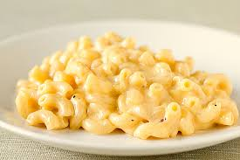
Possible “How To” Topics
HOW TO MAKE:
  Omlet
  Fruit smoothie
  Peanut butter/jelly sandwich
  Grilled cheese
  Macaroni and cheese
  Ice cream sundae
  Queso
  Pancakes

