Slide 1
Name That Country Central America
Spanish II

Slide 2
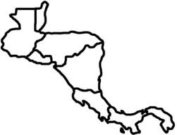
Mexico

Slide 3
Guatemala

Slide 4
Panama

Slide 5
Honduras

Slide 6
El Salvador

Slide 7
Costa Rica

Slide 8
Nicaragua

Slide 9
Pacific Ocean

Slide 10
Caribbean Sea

Slide 11
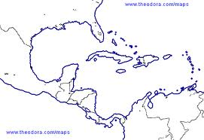
Caribbean Sea
Cuba

Slide 12
Dominican Republic
Caribbean Sea

Slide 13
Caribbean Sea
Puerto Rico

Slide 14
Gulf of Mexico
Caribbean Sea

Slide 15
Caribbean Sea
Caribbean Sea

Slide 16
Atlantic Ocean
Caribbean Sea

Slide 17
Let’s Try Again!

Slide 18
Mexico

Slide 19
Caribbean Sea
Caribbean Sea

Slide 20
Honduras

Slide 21
Dominican Republic
Caribbean Sea

Slide 22
Nicaragua

Slide 23
Caribbean Sea
Cuba

Slide 24
Panama

Slide 25
Gulf of Mexico
Caribbean Sea

Slide 26
Guatemala

Slide 27
Pacific Ocean

Slide 28
Caribbean Sea

Slide 29
Costa Rica

Slide 30
El Salvador

Slide 31
Atlantic Ocean
Caribbean Sea

Slide 32
One More Time!

Slide 33
Caribbean Sea
Puerto Rico

Slide 34
Mexico

Slide 35
Guatemala

Slide 36
Gulf of Mexico
Caribbean Sea

Slide 37
Panama

Slide 38
Caribbean Sea
Cuba

Slide 39
Honduras

Slide 40
El Salvador

Slide 41
Atlantic Ocean
Caribbean Sea

Slide 42
Costa Rica

Slide 43
Dominican Republic
Caribbean Sea

Slide 44
Nicaragua

Slide 45
Caribbean Sea
Caribbean Sea

Slide 46
Pacific Ocean

Slide 47
Caribbean Sea
Puerto Rico

Slide 48
Caribbean Sea

