Slide 1
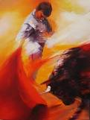
Bullfighting
Spanish II

Slide 2
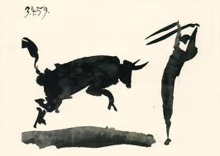
Bullfighting
PowerPoint
Video
Discussion

Slide 3
WARNING
The following pictures may be graphic to some people. Discretion is advised.

Slide 4
El Vocabulario
La corrida de toros
Matador/torero
Picador
Banderillero
Mozo de espadas
Cuadrilla
Tercios
bullfighting
bullfighter
lancer on horseback
puts sharp sticks in bull
sword page
entourage
Thirds (of bullfight)

Slide 5
El Vocabulario
Paseíllo
Traje de luces
Capote
Vara
Peto
Banderillas
Muleta
Parade into arena
“suit of lights”
magenta/gold cape
lance (picador)
protective pad for horse
sharp barbed sticks
sword

Slide 6
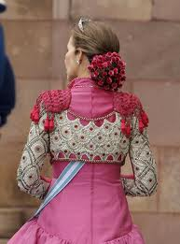
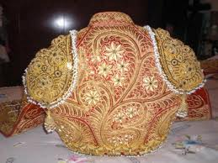
traje de luces

Slide 7
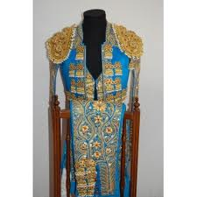
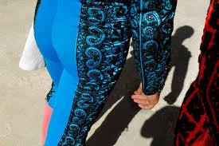
traje de luces

Slide 8
PartParts of the traje de luces

Slide 10
La plaza de toros: bullring

Slide 12
picador

Slide 13
picador

Slide 14
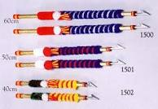
banderilla

Slide 15
banderillero

Slide 16
banderillero

Slide 17
banderillero

Slide 27
b

Slide 53
Videos
Brief Explanation of a Bullfight (2 minutes)
"A Majestic Death“ (3 minutes)
"Being a Bullfighter“ (17 minutes)

Slide 54
YouTube Videos
Barcelona Bullfight (5 min)
Anti-Bullfighting Ad (1 min)
Running of the Bulls

