Slide 1
-AR Verbs
Spanish II

Slide 2
To help: ayudar

Slide 3
“just” + verb: acabar de + infinitive

Slide 4
To rent a video: alquilar un video

Slide 5
To camp: acampar

Slide 6
To ride a bike: montar en bicicleta

Slide 7
To dance: bailar

Slide 8
To celebrate: celebrar

Slide 9
To have dinner: cenar

Slide 10
To cook: cocinar

Slide 11
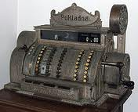
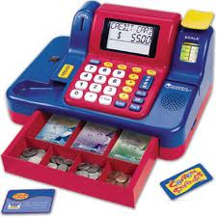
To buy: comprar

Slide 12
To answer:contestar

Slide 13
To converse: conversar

Slide 14
To have breakfast: desayunar

Slide 15
To look for, search: buscar

Slide 16
To sing: cantar

Slide 17
To walk: caminar, andar

Slide 18
To teach: enseÑar

Slide 19
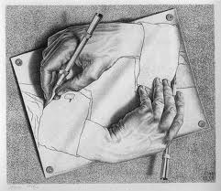
To draw: dibujar

Slide 20
To listen to the radio / music: escuchar la radio /música

Slide 21
To study: estudiar

Slide 22
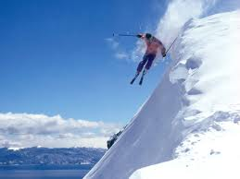
To ski: esquiar

Slide 23
To hope + verb: esperar + infinitive

Slide 24
To be: estar

Slide 25
To explain: explicar

Slide 26
To spend: gastar

Slide 27
To hate: odiar

Slide 28
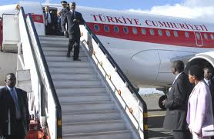
To arrive: llegar

Slide 29
To take, to wear: llevar

Slide 30
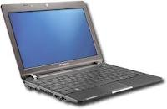
To send an e-mail/text: maNdar un correo electrónico / un texto

Slide 31
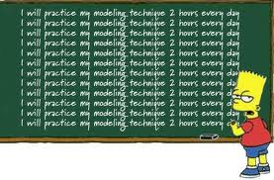
To practice; practicar

Slide 32
To ride a horse: montar a caballo

Slide 33
To swim: nadar

Slide 34
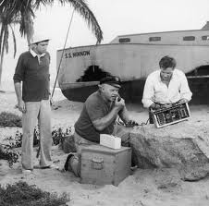
To need + verb: necesitar + infinitive

Slide 35
To be pleasing (like): gustar

Slide 36
To ask: preguntar

Slide 37
To speak, talk: hablar

Slide 38
To invite: invitar

Slide 39
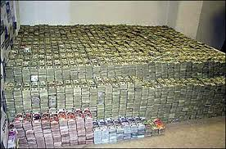
To pay: pagar

Slide 40
To prepare: preparar

Slide 41
To lend: prestar

Slide 42
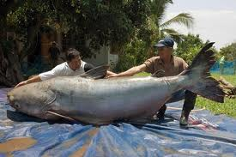
To fish: pescar

Slide 43
To walk, stroll: pasear

Slide 44
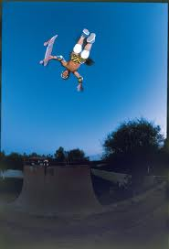
To (in-line) skate: patinar (en línea)

Slide 45
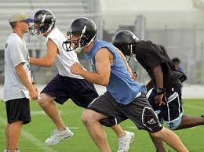
To practice sports: practicar deportes

Slide 46
To give (gift): regalar

Slide 47
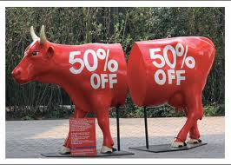
To haggle over, bargain: regatear

Slide 48
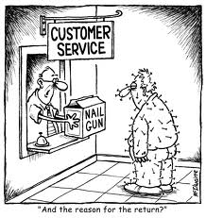
To return: regresar

Slide 49
To get a good grade: sacar una Buena nota

Slide 50
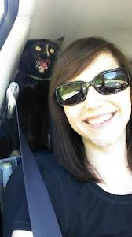
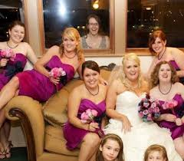
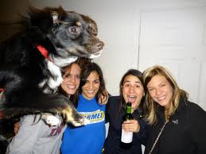
To take pictures: sacar / tomar fotos

Slide 51
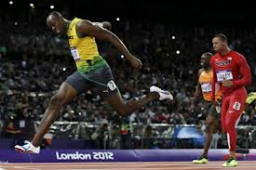
To finish: terminar

Slide 52
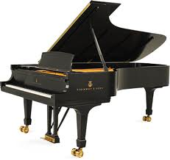
To play (instrument): tocar

Slide 53
To take: tomar

Slide 54
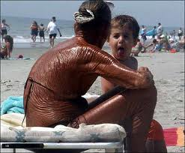
To sunbathe: tomar el sol

Slide 55
To work: trabajar

Slide 56
To watch movies / TV: ver películas / la televisión

Slide 57
To travel: viajar

Slide 58
To visit: visitar

Slide 59
To use: usar

