Slide 1
-AR Verbs
Spanish II

Slide 2
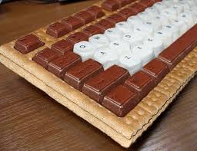
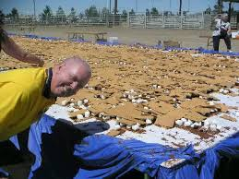
Acampar to camp

Slide 3
Alquilar un video to rent a movie

Slide 4
TO WALK
ANDAR
Speed Walking London Olympics 2012

Slide 5
TO HELP
Whose Line is it anyway? Helping Hands
AYUDAR

Slide 6
TO DANCE
Ouch! DWTS Mishap
BAILAR

Slide 7
TO LOOK FOR, TO SEARCH
BUSCAR

Slide 8
TO CHANGE
CAMBIAR

Slide 9
TO WALK
CAMINAR

Slide 10
TO SING
National Anthem
CANTAR

Slide 11
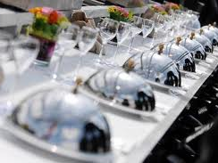
TO HAVE DINNER
Octopus
CENAR

Slide 12
TO COOK
Muppets Chef
COCINAR

Slide 13
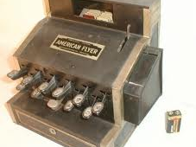
TO BUY
Michael Jackson's Shopping Trip
COMPRAR

Slide 14
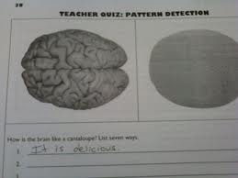
TO ANSWER
CONTESTAR

Slide 15
Desayunar to eat breakfast

Slide 16
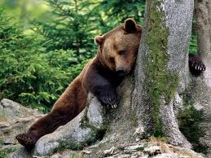
TO REST
Being a Kid is Tough!
DESCANSAR

Slide 17
To want to do something
DESEAR + infinitive

Slide 18
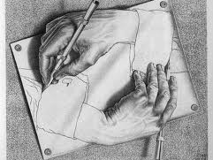
TO DRAW
Paint Jam!
TO DRAW
DIBUJAR

Slide 19
TO TEACH
Teacher's Dancing Prank
ENSEÑAR

Slide 20
TO ENTER
ENTRAR

Slide 21
TO LISTEN
ESCUCHAR

Slide 22
WAIT, EXPECT
Waiting for a bus...
ESPERAR

Slide 23
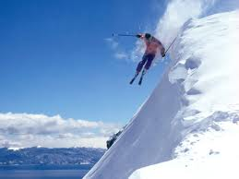
Esquiar to ski

Slide 24
TO STUDY
ESTUDIAR

Slide 25
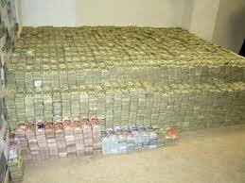
Gastar to spend

Slide 26
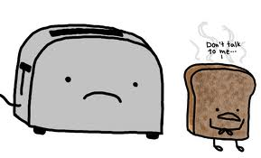
TO TALK, SPEAK
HABLAR
World's Fastest Talking Female

Slide 27
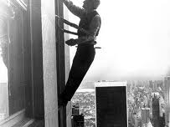
TO CLEAN
LIMPIAR
Spagetti Mess

Slide 28
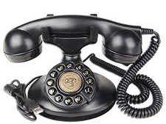
TO CALL
"Call Me Maybe"
LLAMAR

Slide 29
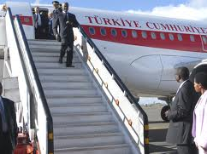
TO ARRIVE
LLEGAR
Tricky Steps

Slide 30
Mandar un texto to send a text

Slide 31
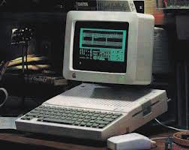
Mandar un correo electrónico to send an e-mail

Slide 32
TO LOOK AT, WATCH
MIRAR
Busta Rhymes Karaoke

Slide 33
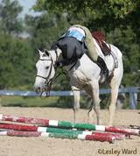
Montar a caballo to ride a horse

Slide 34
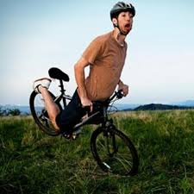
Montar en bicicleta to ride a bike

Slide 35
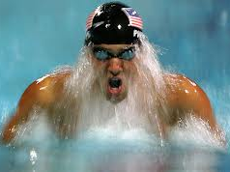
TO SWIM
Legos Swimming?!?
NADAR

Slide 36
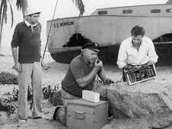
TO NEED
Top Gun
NECESITAR

Slide 37
TO FORGET
OLVIDAR
"Forget About It"

Slide 38
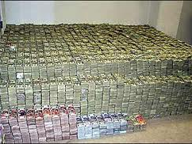
TO PAY
PAGAR
30,000 Pennies

Slide 39
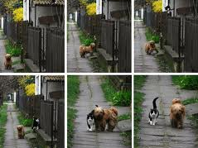
TO GO FOR A WALK
PASEAR

Slide 40
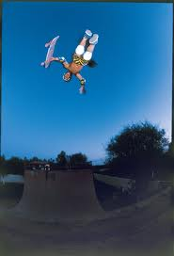
TO SKATE
Tony Hawk
PATINAR

Slide 41
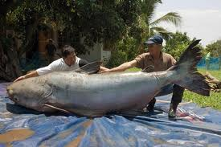
Pescar to fish

Slide 42
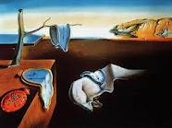
TO PAINT
Avenger Art
PINTAR

Slide 43
TO PRACTICE
PRACTICAR

Slide 44
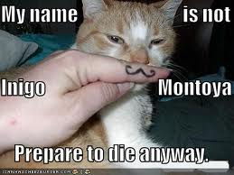
TO PREPARE
Princess Bride
PREPARAR

Slide 45
TO LEND
PRESTAR

Slide 46
TO TAKE OUT, GET
SACAR

Slide 47
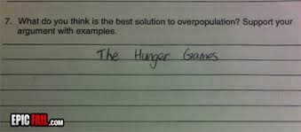
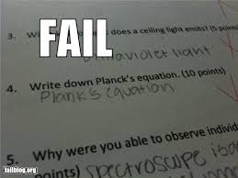
Sacar buenas notas to get good grades

Slide 48
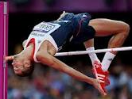
TO JUMP
World's Highest high Jump
SALTAR

Slide 49
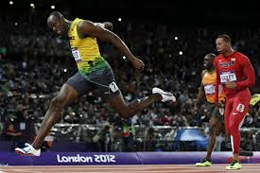
TO END, FINISH
TERMINAR
Usaine Bolt vs. Cheetah

Slide 50
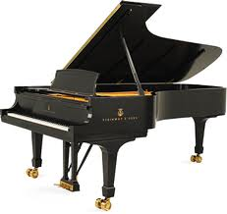
TO PLAY (INSTRUMENT)
TOCAR

Slide 51
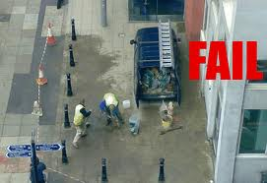
TO WORK
TRABAJAR

Slide 52
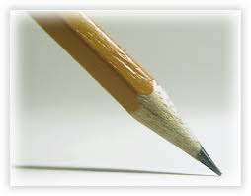
TO USE
USAR

Slide 53
Ver una película to watch a movie

Slide 54
Ver la televisión to watch TV

Slide 55
TO TRAVEL
VIAJAR

Slide 56
TO VISIT
VISITAR

