Slide 1
Adjectives with ESTAR
Spanish II

Slide 2
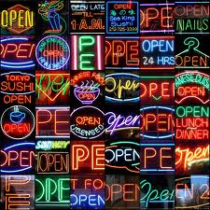
OPEN ABIERTO

Slide 3
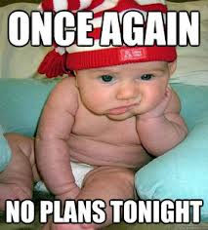
BORED ABURRIDO

Slide 4
GLAD, CHEERFUL ALEGRE
Giggling Baby

Slide 5
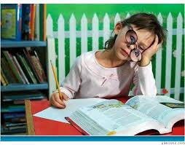
ATTENTIVE ATENTO

Slide 6
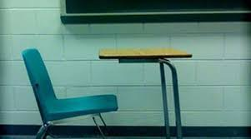
ABSENT AUSENTO
Classic 80's Movie Clip

Slide 7
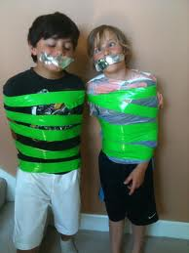
QUIET CALLADO
Quiet Car

Slide 8
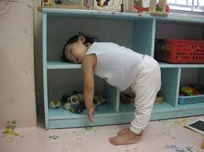
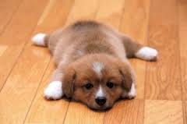
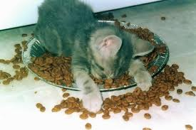
TIRED CANSADO
Tired Toddler

Slide 9
CLOSED CERRADO

Slide 10
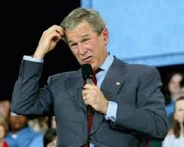
CONFUSED CONFUNDIDO
Confusing Math

Slide 11
CONTENT CONTENTO

Slide 12
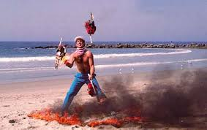
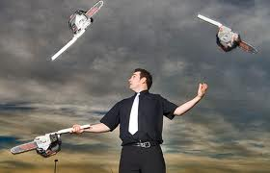
DIFFICULT, HARD DIFICIL
Juggling Chainsaws

Slide 13
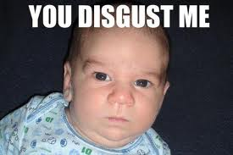
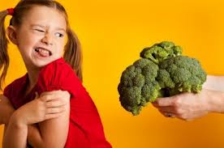
DISGUSTED DISGUSTADO
Disgusted Cat

Slide 14
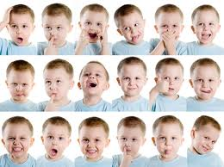
EMOTIONAL EMOCIONANTE
Diego from "Ice Age"

Slide 15
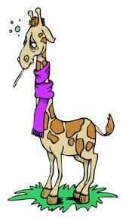
SICK ENFERMO
Melman the Giraffe

Slide 16
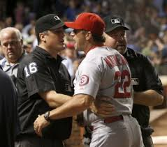
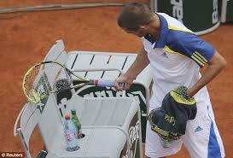
MAD ENOJADO
He's OUT!

Slide 17
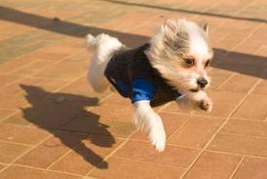
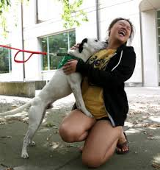
ENTHUSIASTIC ENTUSIASTO

Slide 18
HAPPY FELIZ
Duck Dynasty

Slide 19
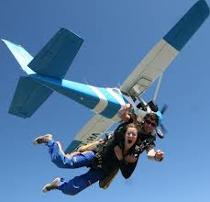
NERVOUS NERVIOSO
Nervous Kid Interview

Slide 20
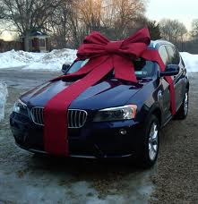
NEW NUEVO

Slide 21
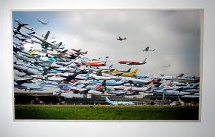
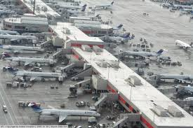
BUSY OCUPADO
Look Both Ways!

Slide 22
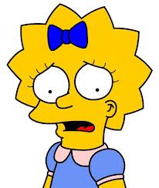
WORRIED PREOCUPADO

Slide 23
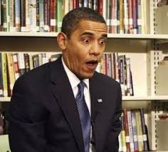
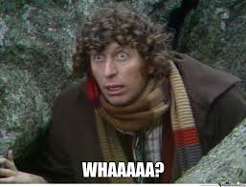
SURPRISED SORPRENDIDO
Surprised Kitty

Slide 24
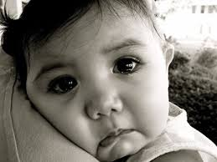
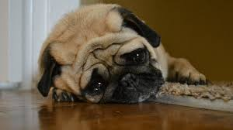
SAD TRISTE
Denver, the Sad Dog

Slide 25
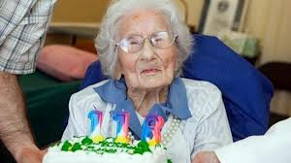
OLD VIEJO
Dancing to Usher

