Slide 1
Adjectives with ESTAR
Spanish II

Slide 2
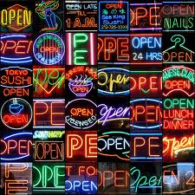
OPEN ABIERTO

Slide 3
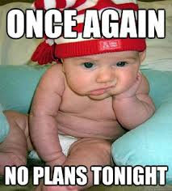
BORED ABURRIDO

Slide 4
GLAD, CHEERFUL ALEGRE
Giggling Baby

Slide 5
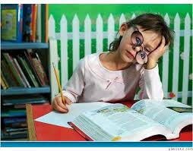
ATTENTIVE ATENTO

Slide 6
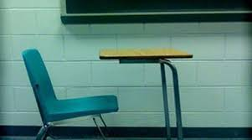
ABSENT AUSENTO
Classic 80's Movie Clip

Slide 7
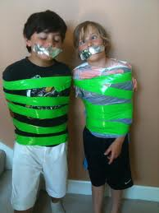
QUIET CALLADO
Quiet Car

Slide 8
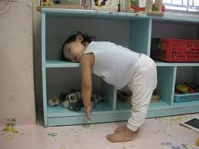
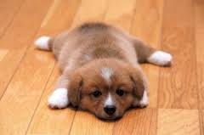
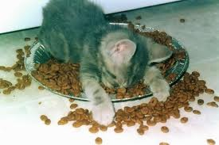
TIRED CANSADO
Tired Toddler

Slide 9
CLOSED CERRADO

Slide 10
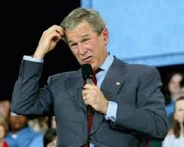
CONFUSED CONFUNDIDO
Confusing Math

Slide 11
CONTENT CONTENTO

Slide 12
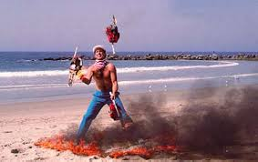
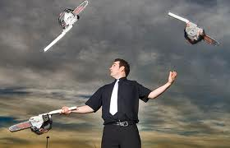
DIFFICULT, HARD DIFÍCIL
Juggling Chainsaws

Slide 13
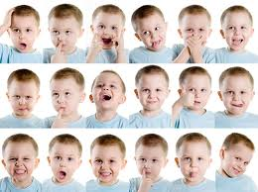
EMOTIONAL EMOCIONANTE
Diego from "Ice Age"

Slide 14
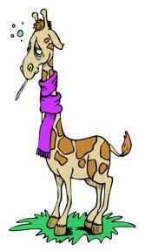
SICK ENFERMO
Melman the Giraffe

Slide 15
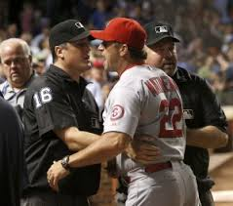
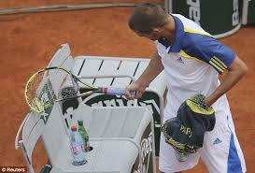
MAD ENOJADO
He's OUT!

Slide 16
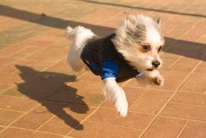
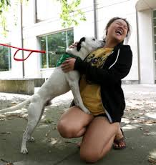
ENTHUSIASTIC ENTUSIASTO

Slide 17
HAPPY FELIZ
Duck Dynasty

Slide 18
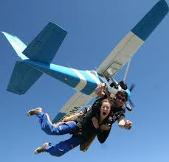
NERVOUS NERVIOSO
Nervous Kid Interview

Slide 19
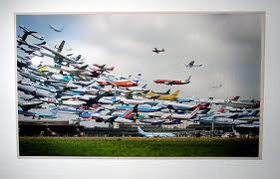
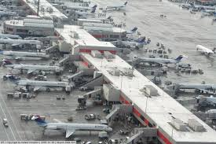
BUSY OCUPADO
Look Both Ways!

Slide 20
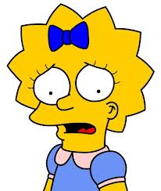
WORRIED PREOCUPADO

Slide 21
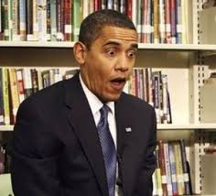
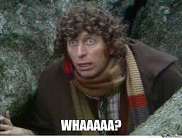
SURPRISED SORPRENDIDO
Surprised Kitty

Slide 22
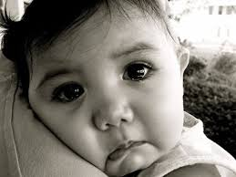
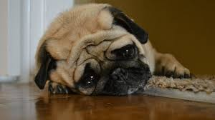
SAD TRISTE
Denver, the Sad Dog

Slide 23
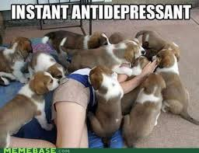
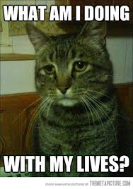
DEPRESSED DEPRIMIDO

Slide 24
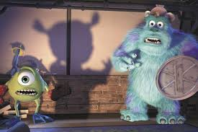
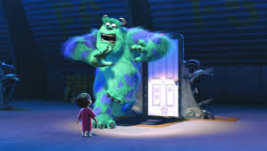
AFRAID ASUSTADO
“Monsters, Inc.”

Slide 25
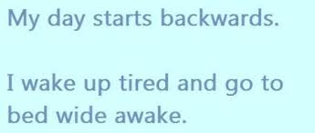
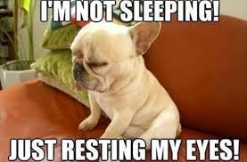
AWAKE DESPIERTO
Poor Baby!

Slide 26
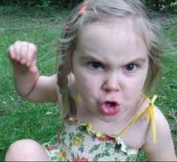
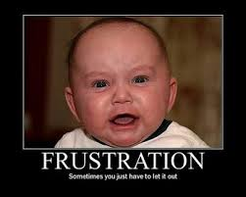
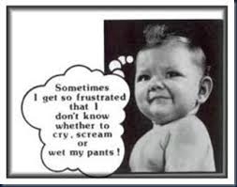
FRUSTRATED FRUSTRADO

Slide 27
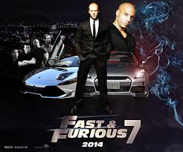
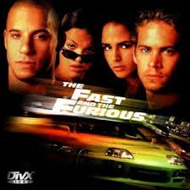
FURIOUS FURIOSO

Slide 28
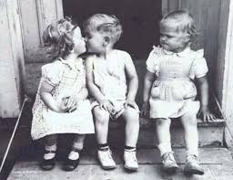
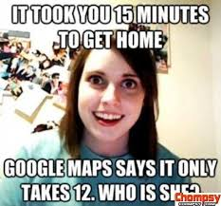
JEALOUS CELOSO

Slide 29
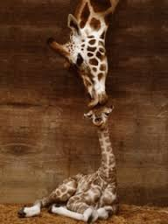
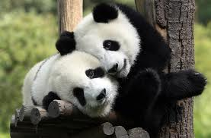
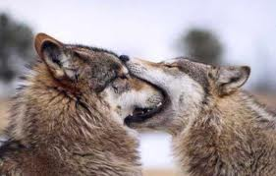
IN LOVE ENAMORADO

