Slide 1
¡Exprésate! UNO Chapter 3
Vocabulario 3-2
Everyday Activities

Slide 2
To study

Slide 3
To study estudiar Two and a Half Men Studying

Slide 4
To rest

Slide 5
To rest descansar Snoring Dog

Slide 6
To work

Slide 7
To work trabajar

Slide 8
To practice sports

Slide 9
To practice sports practicar deportes Sports Bloopers

Slide 10
To play the piano

Slide 11
To play the piano tocar el piano Piano Prodigy

Slide 12
To talk on the phone

Slide 13
To talk on the phone Hablar por teléfono Cell Phone Commercial

Slide 14
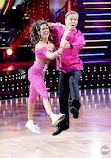
To dance

Slide 15
To dance bailar Dancing Bloopers

Slide 16
Where are you going this weekend?

Slide 17
Where are you going this weekend?
¿Adónde vas los fines de semana?

Slide 18
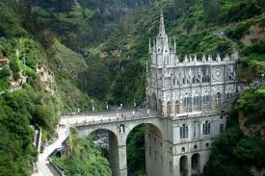
to church

Slide 19
to church a la iglesia

Slide 20
I’m going …

Slide 21
I’m going … Yo voy…

Slide 22
to the pool

Slide 23
to the pool a la piscina Diving Excerpts

Slide 24
to the gym

Slide 25
to the gym al gimnasio World's Strongest Man

Slide 26
to the beach

Slide 27
to the beach a la playa Surfing Wipeout

Slide 28
to the dance

Slide 29
to the dance al baile Footloose Prom

Slide 30
to _____’s house

Slide 31
to _____’s house a la casa de …

Slide 32
to school

Slide 33
to school al colegio

Slide 34
to rehearsal

Slide 35
to rehearsal al ensayo

Slide 36
to (sports) practice

Slide 37
to (sports) practice al entrenamiento

Slide 38
to the meeting

Slide 39
to the meeting a la reunión

Slide 40
to work

Slide 41
to work al trabajo

